Slide 1
DB 변경하기 (H2DB → MariaDB)

Slide 2
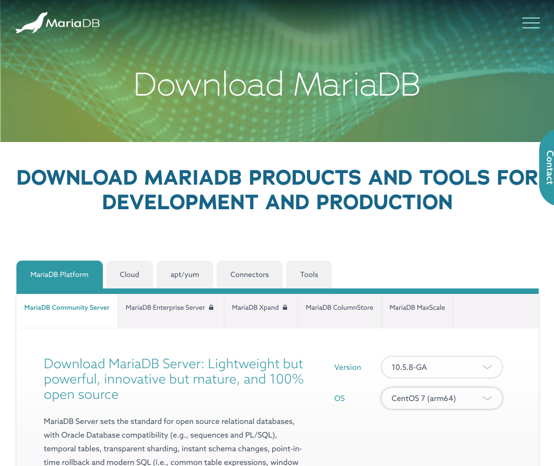
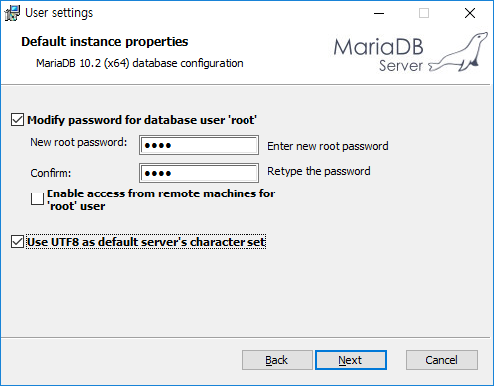

MariaDB 설치 – Windows 10
사이트 : https://mariadb.com/downloads
설치 옵션
New root password: root
Use UTF8 as default server’s character set 체크

Slide 3
MariaDB 설치 – Mac
brew install mariadb
sudo mysqld_safe --skip-grant-tables
sudo mariadb-secure-installation (10.4.6 이하에서는 mysql_secure_installation)
Enter current password for root (enter for none): (Enter)
Enable unix_socket authentication? [Y/n] n
Change the root password? [Y/n] y
New password:
Re-enter new password:
Remove anonymous users? [Y/n] y
Disallow root login remotely? [Y/n] y
Remove test database and access to it? [Y/n] y
Reload privilege tables now? [Y/n] y
brew services start mariadb (확인 : brew services list)
mariadb -u root -p

Slide 4
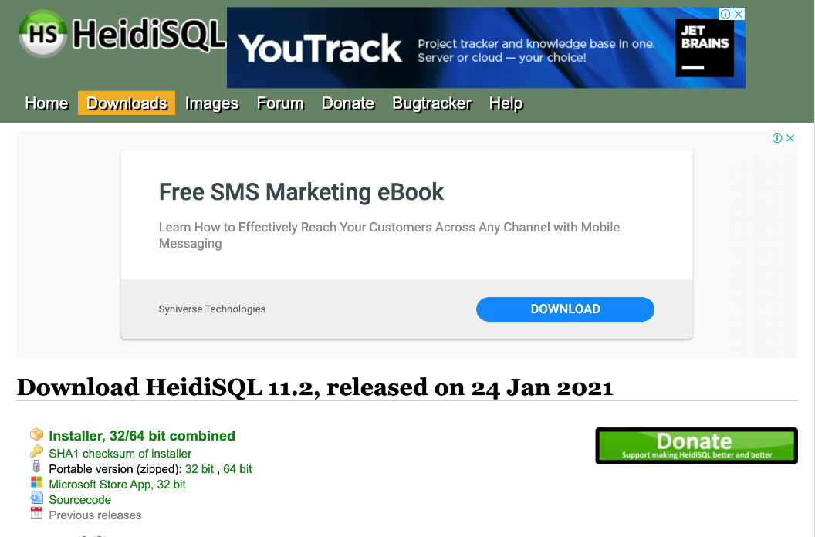
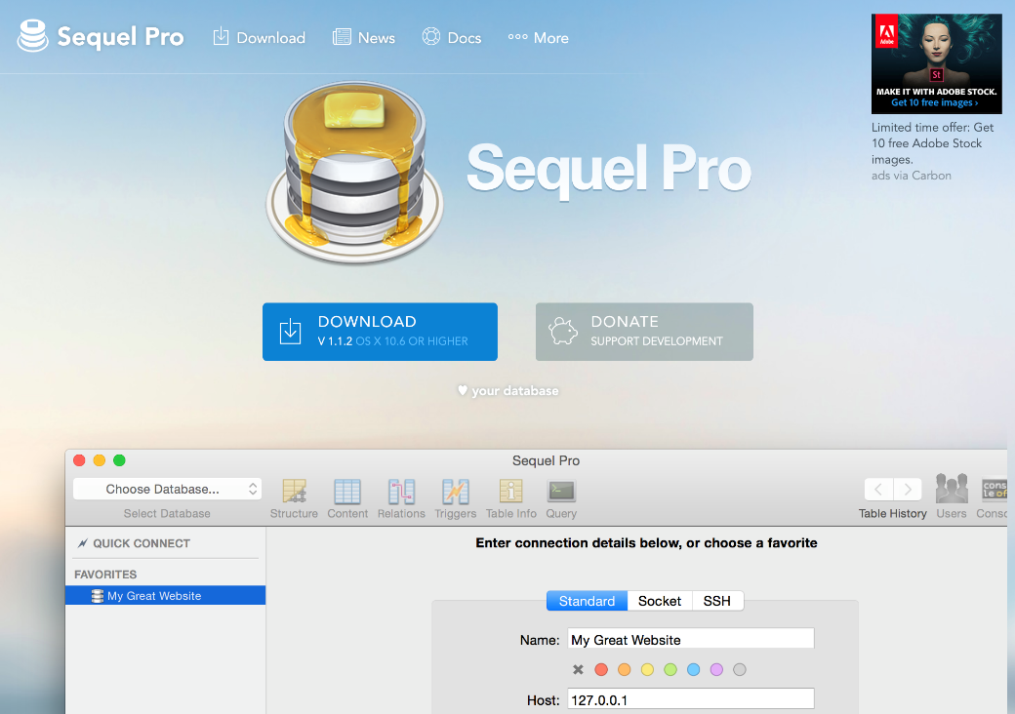
MariaDB Client 설치
사이트 : https://www.heidisql.com/download.php
MariaDB 설치 시, 함께 설치
사이트 : https://www.sequelpro.com/

Slide 5
Spring Boot Project 설정
application.yml 수정
spring:
application:
name: factory-demo
profiles:
active: default
datasource:
url: jdbc:h2:mem:testdb
username: sa
password:
driver-class-name: org.h2.Driver
jpa:
hibernate:
ddl-auto: create
properties:
hibernate:
format_sql: true
h2:
console:
enabled: true
path: /h2-console
server:
port: 8080
logging:
level:
org.hibernate.SQL: debug
spring:
application:
name: factory-demo
profiles:
active: default
datasource:
url: jdbc:mysql://localhost:3306/test
username: root
password: root
driver-class-name: org.mariadb.jdbc.Driver
jpa:
hibernate:
ddl-auto: create
properties:
hibernate:
format_sql: true
# h2:
# console:
# enabled: true
# path: /h2-console
server:
port: 8080
logging:
level:
org.hibernate.SQL: debug

Slide 6
Spring Boot Project 설정
pom.xml 수정
<dependencies>
...
<dependency> <groupId>org.mariadb.jdbc</groupId> <artifactId>mariadb-java-client</artifactId> </dependency>
...
</dependencies>

Slide 7
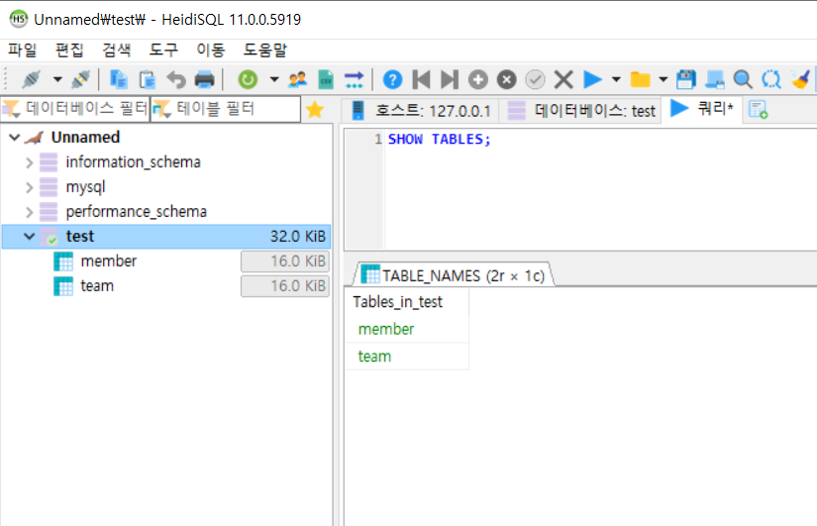
DB 확인
테이블 생성 확인

